Slide 1
Unit-3

Slide 2

Software Project Management
4th Edition
Chapter 7
Risk management
Notes:
This talk provides an overview of the basic steps needed to produce a project plan. The framework provided should allow students to identify where some of the particular issues discussed in other chapters are applied to the planning process. As the focus is on project planning, techniques to do with project control are not explicitly described. However, in practice, one element of project planning will be to decide what project control procedures need to be in place.

Slide 3
RISK
PM-BOK defines risk as ‘an uncertain event or condition that, if it occurs, has a positive or negative effect on a project’s objectives’
PRINCE2, the UK government sponsored project management standard, defines risk as ‘the chance of exposure to the adverse consequences of future events’
People may use different terms, but the key elements of a risk follow
It relates to the future: risk planning involves speculating about future events.
It involves cause and effect: for ex ‘cost over-run’ might be identified as a risk, but the simple description of ‘cost over-run’ gives the consequence of some adverse event.

Slide 4
Categories of risk
Project risks:
- could prevent the achievement of the objectives gives to the project manager and project team.
Business risks:
- likely to be outside the direct responsibilities of the application implementation team.
failure to meet any project objective---- negative impact
increase in development cost might mean income –
increased investment

Slide 5
Actors
Structure
Technology
Tasks

Slide 6
Actors: refers to all the people involved in the development of the application in question.
These includes the various development specialists, the different user groups and managers with differing responsibilities.
A typical risk in this area is that high staff turnover leads to information of value to the project being lost.
If a software developer builds a software component and then leaves before it has been fully tested. The team member taking over that component might find that their lack of familiarity with the software makes diagnosis and correction of faults difficult.

Slide 7
“Technology “: encompasses both the technology used to implement the application and that embedded in the delivered products.
“Structure” describes the management structures and system, including those affecting planning and control.
“Tasks” relates to the work to be carried out.

Slide 8
A framework for dealing with risk
Planning for risk includes these steps:
  Risk identification – what are the risks to a project?
  Risk analysis – which ones are really serious?
  Risk planning – what shall we do?
  Risk monitoring – has the planning worked?

Slide 9
Risk identification
Checklists
Brainstorming

Slide 10
Risk identification
Approaches to identifying risks include:
Use of checklists – usually based on the experience of past projects
Brainstorming – getting knowledgeable stakeholders together to pool concerns
Causal mapping – identifying possible chains of cause and effect

Slide 11
Boehm’s top 10 development risks
Risk | Risk reduction techniques
Personnel shortfalls | Staffing with top talent; job matching; teambuilding; training and career development; early scheduling of key personnel
Unrealistic time and cost estimates | Multiple estimation techniques; design to cost; incremental development; recording and analysis of past projects; standardization of methods
Developing the wrong software functions | Improved software evaluation; formal specification methods; user surveys; prototyping; early user manuals
Developing the wrong user interface | Prototyping; task analysis; user involvement
Notes:
Barry Boehm surveyed software engineering project leaders to find out the main risks that they had experienced with their projects. For each risk, some risk reduction techniques has been suggested.

Slide 12
Boehm’s top ten risk - continued
Gold plating | Requirements scrubbing, prototyping, design to cost
Late changes to requirements | Change control, incremental development
Shortfalls in externally supplied components | Benchmarking, inspections, formal specifications, contractual agreements, quality controls
Shortfalls in externally performed tasks | Quality assurance procedures, competitive design etc
Real time performance problems | Simulation, prototyping, tuning
Development technically too difficult | Technical analysis, cost-benefit analysis, prototyping , training
Notes:
‘Gold plating‘ refers to inclusion of features that in fact are unnecessary and which end up never actually being used.

Slide 13
Brainstorming
Representatives of the main stakeholders can be brought together, ideally once some kind of preliminary plan has been drafted.
They then identify using their individual knowledge of different parts of the project, the particular problems that might occur.
Brainstorming can also be used to identify possible solutions to the problems that emerge.

Slide 14
Causal mapping
One way of identifying possible threats to the success of a project and the measures that might eliminate or reduce them is the use of causal mapping.
The node represent various factors Concept variable not an activity.
First diagram vicious circle where delays in meeting deadlines lead to increased management pressure. This in turn cause staff turnover to increase which leads to further delays in meeting deadlines.
The second destabilizing effect on the project of uncontrolled external influence ,such as an unstable environment leading to continual changes to requirement.

Slide 15
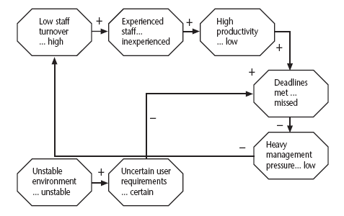
Causal mapping
Notes:
The idea here is to get the major stakeholders together and to brainstorm collectively the things that could go wrong. The causes of the problems identified are traced back using the mapping technique which identifies the project factors ( or ‘concept variables’) that people see as being important and the causal links between them. These links can be positive or negative.
Where possible, for each factor, positive and negative aspects are identified e.g. ‘stable…unstable requirements’.

Slide 16
Risk assessment
Risk exposure (RE) = (potential damage) x (probability of occurrence)
It might be estimated that if a flood occurred a new computer configuration could be installed and software developed again from scratch for 500,000.
It might also be estimated that where the computer is located there is 1 in 100 chance of flooding actually happening. That probability o f 0.01.
500,000 X 0.01= 5,000
Crudely analogous to the amount needed for an insurance premium

Slide 17
Risk probability: qualitative descriptors
Probability level | Range
High | Greater than 50% chance of happening
Significant | 30-50% chance of happening
Moderate | 10-29% chance of happening
Low | Less than 10% chance of happening
Notes:
Managers would be happier identifying an approximate range rather than a precise probability.

Slide 18
Qualitative descriptors of impact on cost and associated range values
Impact level | Range
High | Greater than 30% above budgeted expenditure
Significant | 20 to 29% above budgeted expenditure
Moderate | 10 to 19% above budgeted expenditure
Low | Within 10% of budgeted expenditure.
Notes:
Similar tables can be produced for the impact on project duration and on the quality of project deliverables.
The problem with the qualitative approach is how do you combine the judgements about probability and impact – you can’t multiply them together.

Slide 19
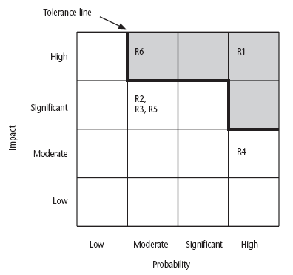
Probability impact matrix
Notes:
R1, R2 etc refer to particular risks (See Table 7.4 in the textbook). They are located on the grid according to the likelihood and impact ratings that have been allocated to them. A zone around the top right hand corner of the grid can be designated and risks falling within that zone are treated as requiring urgent action.

Slide 20
Risk planning
Risks can be dealt with by:
Risk acceptance
Risk avoidance
Risk reduction
Risk transfer
Risk mitigation/contingency measures
Notes:
Risk acceptance – the cost of avoiding the risk may be greater than the actual cost of the damage that might be inflicted
Risk avoidance – avoid the environment in which the risk occurs e.g. buying an OTS application would avoid a lot of the risks associated with software development e.g. poor estimates of effort.
Risk reduction – the risk is accepted but actions are taken to reduce its likelihood e.g. prototypes ought to reduce the risk of incorrect requirements
Risk transfer – the risk is transferred to another person or organization. The risk of incorrect development estimates can be transferred by negotiating a fixed price contract with an outside software supplier.
Risk mitigation – tries to reduce the impact if the risk does occur e.g. taking backups to allow rapid recovery in the case of data corruption

Slide 21
Risk reduction leverage
Risk reduction leverage =
(RE_{before}- RE_{after})/ (cost of risk reduction)
RE_{before}is risk exposure before risk reduction e.g. 1% chance of a fire causing £200k damage
RE_{after} is risk exposure after risk reduction e.g. fire alarm costing £500 reduces probability of fire damage to 0.5%
RRL = (1% of £200k)-(0.5% of £200k)/£500 = 2
RRL > 1.00 therefore worth doing
Notes:
If you think in terms of the analogy to insurance. An insurance company might reduce the fire insurance premium from £2k to £1k on condition that a fire alarm is installed. The insured would save £1k a year by investing £500 so it would be worth doing.

Slide 22
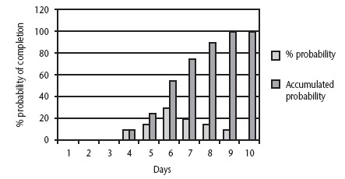
Probability chart
Notes:
As was pointed out in Chapter 5, an estimate of activity duration is realistically a range of values clustered around the most likely value are trailing off on either side of this central value.
How can we take account of this in project planning. An answer might be the PERT risk technique.

Slide 23
Using PERT to evaluate the effects of uncertainty
Three estimates are produced for each activity
Most likely time (m)
Optimistic time (a)
Pessimistic (b)
‘expected time’ t_{e} = (a + 4m +b) / 6
‘activity standard deviation’ S = (b-a)/6
Notes:
Most likely time (m) the time we would expect the task to take normally
Optimistic time (a) the shortest time could be realistically be expected
Pessimistic (b) worst possible time (only 1% chance of being worse, say)
Some straightforward activities (data input of standing data might perhaps be an example) might have little uncertainty and therefore have a low standard deviation, while others (software design, for instance?) have more uncertainty and would have a bigger standard deviation.
Exercise 7.6 in the textbook will give some practice in calculating these values.

Slide 24
A chain of activities
Task A
Task B
Task C
Task | a | m | b | t_{e} | s
A | 10 | 12 | 16 | ? | ?
B | 8 | 10 | 14 | ? | ?
C | 20 | 24 | 38 | ? | ?
Notes:
Fill the missing gaps?
T_{e}
Task A t_{e} = (10+ (12 x 4) + 16)/ 6 i.e. 12.66 s = (16-10)/6 i.e. 1
Task B t_{e} = (8 + (10 x 4) + 14)/ 6 i.e. 10.33 s = (14-8)/6 i.e. 1
Task C T_{e} = (20 + (24 x 4) + 38)/6 i.e. 25.66 s = (38-20)/6 i.e. 3

Slide 25
A chain of activities
What would be the expected duration of the chain A + B + C?
Answer: 12.66 + 10.33 + 25.66 i.e. 48.65
What would be the standard deviation for A + B+ C?
Answer: square root of (1² + 1² + 3²) i.e.
3.32
Notes:
Get them to guess the square root if no one has a laptop with excel or a scientific calculator!

Slide 26
Assessing the likelihood of meeting a target
Say the target for completing A+B+C was 52 days (T)
Calculate the z value thus
z = (T – t_{e})/s
In this example z = (52-48.33)/3.32 i.e. 1.01
Look up in table of z values – see next overhead

Slide 27
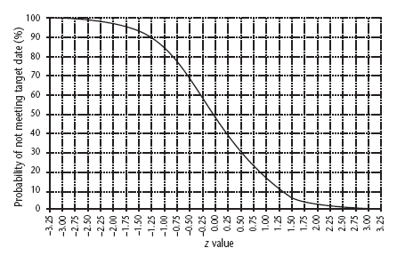
Graph of z values
Notes:
There is about a 15% chance of not meeting the target of 52 days.

Slide 28
Software Project Management
4th Edition
Chapter 8
Resource allocation
Notes:
This talk provides an overview of the basic steps needed to produce a project plan. The framework provided should allow students to identify where some of the particular issues discussed in other chapters are applied to the planning process. As the focus is on project planning, techniques to do with project control are not explicitly described. However, in practice, one element of project planning will be to decide what project control procedures need to be in place.

Slide 29
Schedules
Activity schedule - indicating start and completion dates for each activity
Resource schedule - indicating dates when resources needed + level of resources
Cost schedule showing accumulative expenditure
Notes:
We have already described the creation of the activity schedule in Lecture/activity 6.

Slide 30
Resource fall into seven categories
Labour: members of the development project team such as the project manager, systems analysts and software developers.
Equipment: include workstations and other computing and office equipment . Staff also need basic equipment and desks and chairs.
Materials: materials are item that are consumed [H/W and S/W]
Space: for project that are undertaken with existing staff, space is normally readily available.

Slide 31
Service: some project will require procurement of specialist services-development of wide area distributed system, ex requires scheduling of telecommunications services.
Time: Time is the resource that is being offset against the other primary resource –project timescales can sometimes be reduced by increasing other resources.
[elapsed time can often be reduced by adding more staff]
Money: money is secondary resource is used to buy other resources.

Slide 32
Resource allocation
Identify the resources needed for each activity
Identify resource types - individuals are interchangeable within the group (e.g. ‘VB programmers’ as opposed to ‘software developers’)
Allocate resource types to activities and examine the resource histogram
Notes:
This is covered in Section 8.3 of the text.
Note that at this point we have to assume that we are dealing with, for example, ‘standard’ software developers who have an average productivity. When we allocate actual people we may find that we have a trainee or a super-expert and this will affect productivity. A short-coming in productivity in an individual might be compensated for by a lower cost (as would be expected with trainees).
In the example in the text we start by scheduling every activity to start at the earliest possible date. However in Lecture/Chapter 7, in the section on the critical chain technique it was suggested that we plan to start activities as late as possible. Whatever the starting procedure, we then need to deal with resource clashes.

Slide 33
Resource histogram: systems analysts
5
4
STAFF REQD.
3
2
1
1
2
3
4
5
6
7
WEEK
Notes:
The resource histogram helps us identify where the demand for a resource exceeds the supply.
If we use a tool such as MS Project, the tool will generate the resource histograms for us.

Slide 34
Resource clashes
can be resolved by:
  delaying one of the activities
    taking advantage of float to change start date
    delaying start of one activity until finish of the other activity that resource is being used on - puts back project completion
  moving resource from a non-critical activity
  bringing in additional resource - increases costs
Notes:
Exercise 8.1 in the text gives some practice in the resolution of resource clashes.

Slide 35
Prioritizing activities
There are two main ways of doing this:
Total float priority –
Activities are ordered according to their total float, those with the smallest float have the highest priority.
simplest app- activities are allocated resources in ascending order of total float.
Ordered list priority – activates that can proceed at the same time are ordered according to a set of simple
Notes:
Where more than one activity is competing for the same limited resource at the same time then those activities need to be prioritized.

Slide 36
Burman’s priority list
Give priority to:
Shortest critical activities
Other critical activities
Shortest non-critical activities
Non-critical activities with least float
Non-critical activities

Slide 37
Creating Critical path
Scheduling resources can create new critical paths.
Delaying the start of an activity because of lack of resources will cause that activity to become critical if this up its float.
Delay in completing one activity can delay the availability of a resource required for a later activity
If the later one is already critical then the earlier one might now have been made critical by linking their resources.
Notes:
In Lecture/chapter 7 the concept of critical chains was introduced which took account of resource constraints.
The point about not adding links to the network to deal with resource constraints is not in the text, but is based on practical experience. The notation for activity networks does not tell you why one activity might be dependent on the completion of another.

Slide 38
Allocating individuals to tasks
The initial ‘resource types’ for a task have to be replaced by actual individuals.
Factors to be considered:
Availability
Criticality
Risk
Training
Team building – and motivation
Notes:
Availability – who is free? Note that this will change during the course of the project as some tasks are completed earlier or later than planned
Criticality – You would want to put your more experienced, ‘safer’, staff on the critical activities
Risk – this is similar to the point above, but some activities could be off the critical path but still have risks e.g. to the quality of subsequent products
Training – despite concerns about minimizing risk, it is healthy to take some risks in order to develop staff capabilities by allocating challenging tasks to relatively inexperienced stafff
Team-building – identifying people who work well together can pay dividends; chopping and changing plans all the time may in theory optimize project performance, but can in practice be demotivating for staff

Slide 39
Availability : we need to know whether a particular individual will be available when required
Critically: allocation of more experienced personnel to activates on the critical path often helps in shortening project durations or at least reduces the risk of overrun.
Risk: Allocating the most experienced staff to the highest-risk activities is likely to have the greatest effect in reducing overall project uncertainties.
More experienced staff are , usually more expensive.

Slide 40
Training: It will benefit the org if positive steps are taken to allocate junior staff to appropriate non-critical activities where there will be sufficient slack for them to train and develop skills.
Team building: The selection of individuals must also take account of the final shape of the project team and the way they will work together.

Slide 41
Cost schedules
Cost schedules can now be produced:
Costs include:
Staff costs: staff salaries as well as other direct costs of employment – contribution to social security funds, pension scheme ,holiday pay and sickness benefit.
Overheads [overheads represent expenditure that org incurs, which cannot be directly related to individual project or job]
Usage charges project are charged directly for use of resource such as computer time- as used basis
Notes:
Section 8.9 covers this in more depth.
Staff costs – includes not just salary, but also social security contributions by the employer, holiday pay etc. Timesheets are often used to record actual hours spent on each project by an individual. One issue can be how time when a staff member is allocated and available to the project, but is not actually working on the project, is dealt with.
Overheads e.g. space rental, service charges etc. Some overheads might be directly attributable to the project; in other cases a percentage of departmental overheads may be allocated to project costs.
Usage charges – some charges can be on a ‘pay as you go’ basis e.g. telephone charges, postage, car mileage – at the planning stage an estimate of these may have to be made

Slide 42
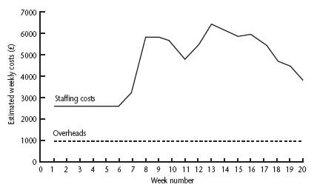
Cost profile
Notes:
This shows how much is going to be spent in each week. This could be important where an organization allocates project budgets by financial year or quarter and the project straddles more than one of these financial periods

Slide 43
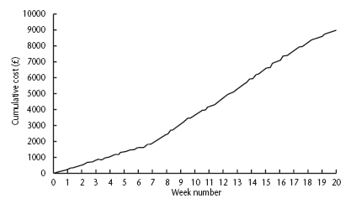
Accumulative costs
Notes:
The project manager will also be concerned about planned accumulative costs. This chart can be compared to the actual accumulative costs when controlling the project to assess whether the project is likely to meet its cost targets.

Slide 44
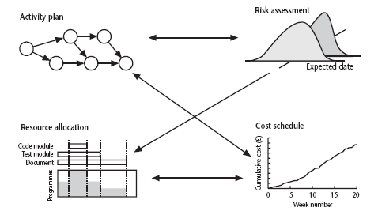
Balancing concerns
Notes:
Successful project scheduling is not a simple sequence.
Because of the inter-linking of different concerns project planning will need to be iterative. The consequences of decisions will need to carefully assessed and plans adjusted accordingly.

Slide 45
Software Project Management
4th Edition
Chapter 9
Monitoring and
Control
Notes:
This talk provides an overview of the basic steps needed to produce a project plan. The framework provided should allow students to identify where some of the particular issues discussed in other chapters are applied to the planning process. As the focus is on project planning, techniques to do with project control are not explicitly described. However, in practice, one element of project planning will be to decide what project control procedures need to be in place.

Slide 46
Project Control Cycle
Start
Publish initial plan
Gather project information
Compare progress Vs targets
Publish revised plan
Regular Monitoring:
Exercising control over a project and ensuring that targets are met
Satisfactory?
No
Take remedial action
Yes
Project completed?
No
Yes
End Pr
Review project
Document conclusions
End

Slide 47
Monitoring
Exercising control over a project and ensuring that targets are met is a matter of regular monitoring, finding out what is happening, and comparing it with current targets.
Replanning is necessary if there is mismatch between the planned outcomes and the actual ones.
Once the initial has been published, project control is a continual process of monitoring progress against the plan

Slide 48
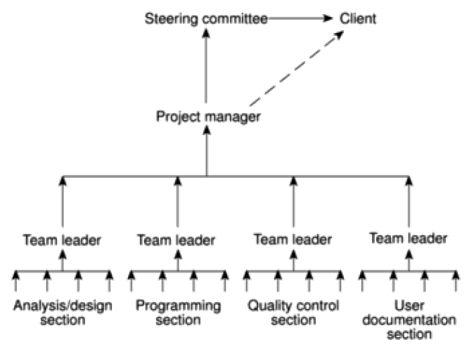
Project Report Structure

Slide 49
Responsibility
Project progress role is done by the project steering committee or project board.
Day – to – day responsibility will rest with the project manager, the smallest part can be delegated to the team members.
Steering committee will directly progress reports for the clients
Reporting may be oral or written, formal or informal, or regular

Slide 50
Assessing progress
It is based on the information collected and collated at regular intervals.
Information will be objective and tangible
Progress assessment will have to rely on the judgment of the team members who are carrying out the project activities.

Slide 51
Setting checkpoints
It is essential to set a checkpoint at the initial activity plan.
  Regular (e.g. monthly)
  Tied to specific events such as production of a report.

Slide 52
Taking snapshots
The frequency with which a manager needs to receive information about progress will depend upon the size and degree of risk of the project.
Team leaders for ex need to assess progress daily whereas project managers may find weekly or monthly reporting appropriate.
Major, or project-level, progress reviews will generally take place at particular points during the life of a project- commonly known as review point or control.

Slide 53
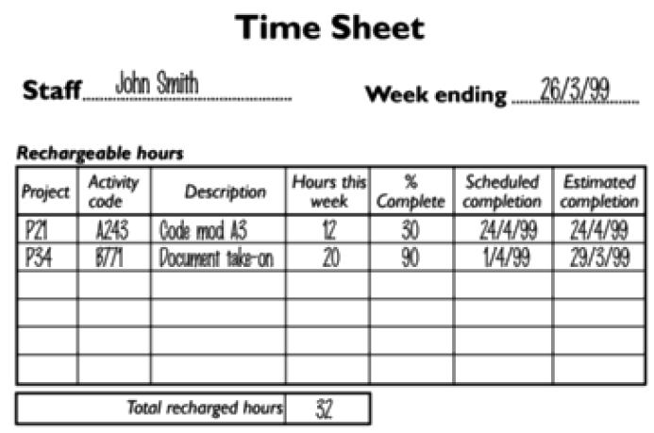
Collecting the Data
Partial completion reporting

Slide 54
Risk reporting
One popular way of overcoming the objections to partial competition reporting is to avoid asking for estimated completion dates, but to ask instead for the team members, estimates of the like hood of meeting the planned target date.
Traffic-light method
Identify the key [first level] elements for assessment in a piece of work.
Break these key elements into constituent elements
[ second level].
Assess each of the second- level elements on the scale green for ‘on target’ amber for ‘not on target but recoverable’, and red for ‘not on target and recoverable only with difficulty’.

Slide 55
Review all the second –level assessments to arrive at first-level assessments.
Review first – and second-level assessments to produce an overall assessment.
Traffic- light assessment highlights only risk of non-achievement; it is not an attempt to estimate work done or to quantify expected delays

Slide 56
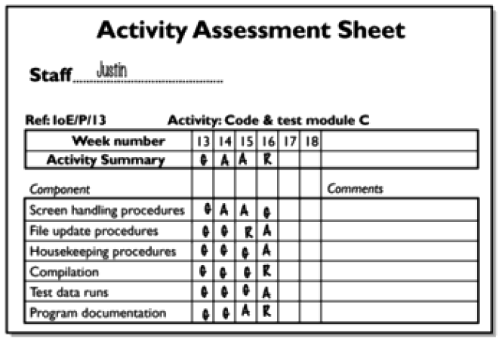
Collecting the Data
Red/amber/green (RAG) reporting

Slide 57
The Gantt chart
One of the simplest and oldest techniques for tacking project progress is the Gantt chart.
This is essentially an activity bar chart indicating scheduled activity dates and durations frequently augmented with activity floats.
Reported progress is recorded on the chart and a today cursor provides an immediate visual indication of which activates are ahead or behind schedule

Slide 58
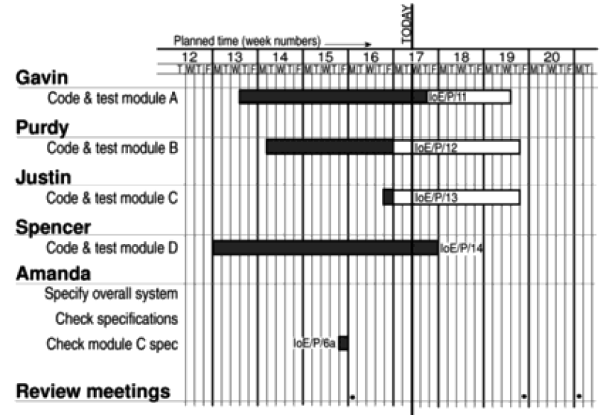
Visualizing Process
The Gantt Chart

Slide 59
The slip chart
A slip chart is a very similar alternative favored by some project managers who believe it provides a more striking visual indication of those activities that are not progressing to schedule- the more the slip line bends, the greater the variation from the plan
A very jagged slip line indicates a need for rescheduling.

Slide 60
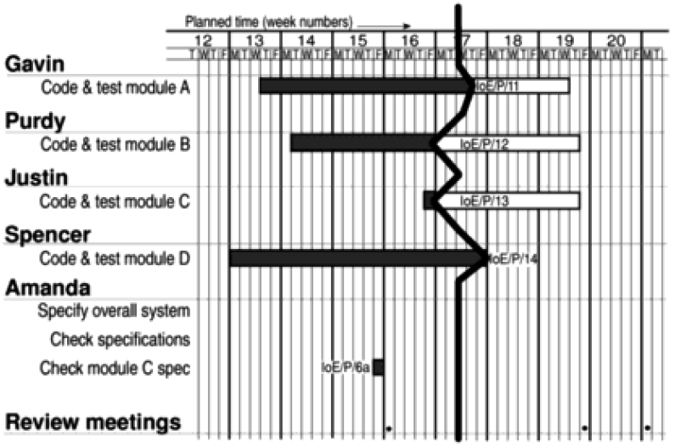
Visualizing Process
The Slip Chart

Slide 61
Ball charts
The circles indicate start and completion points for activities.
The circles initially contain the original scheduled dates.
Where the actual start or finish date for an activity is later than the target date, the circle is coloured red, where an actual date is on time or earlier than the target then the circle is coloured green.
Adv- ball charts over Gantt and slip charts is that they are relatively easy to keep up to date –only the dates and possible colours need to be changed, whereas the others need to be redrawn each time target dates are revised.

Slide 62
31/3/07
31/3/07
11/5/07
21/5/07
Code and test module A
6/4/07
8/4/07
Code and test module B
13/5/07
17/5/07
21/4/07
23/4/07
Code and test module C
12/5/07
11/5/07

Slide 63
The Timeline
One disadvantage of the charts described so far is that they do not show clearly the slippage of the project completion date through the life of the project.
Knowing the current state of a project helps in revising plans to bring it back on target, but analyzing and understanding trends helps to avoid slippage in future projects.
The timeline chart is method of recording and displaying the way in which targets have changed throughout the duration of the project.
Useful both during the execution of a project and as part of the post-implementation review and the reasons for the changes, can indicate failures in the estimation process or other errors that might, with that knowledge, be avoided in future.

Slide 64
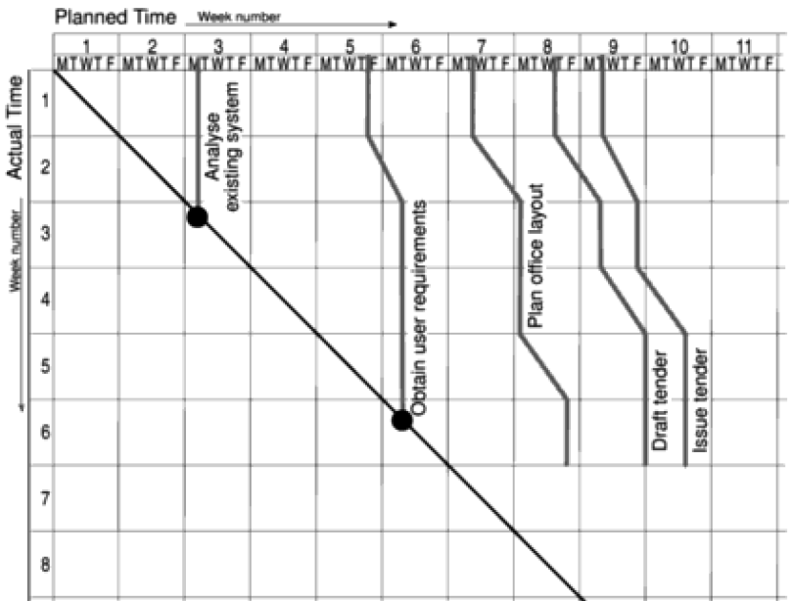
Visualizing Process
The Timeline
The Timeline
Is a method of recording and displaying the way in which targets have changed throughout the duration of the project.

Slide 65
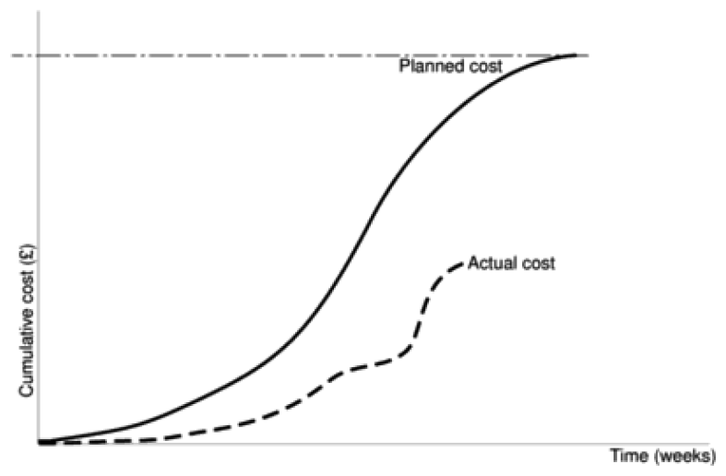
Cost Monitoring
Expenditure monitoring provides an indication of the effort that has gone into a project

Slide 66
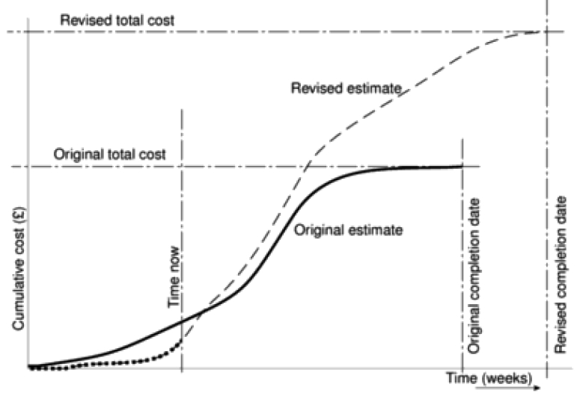
Cost Monitoring

Slide 67
Earned value analysis
Earned value analysis is based on assignment a ‘value’ to each task or work package based on the original expenditure forecasts.
The assigned value is the original budgeted cost for the item and known as the Planned Value (PV) – Budgeted cost of work scheduled (BCWS).
A task that has not started is assigned the value zero and when it has been completed it and hence the project, is credited with the value of the task. The total value credited to a project at any point is known as the Earned Value (EV) – Budgeted cost of work performed (BCWP).

Slide 68
Earned value Analysis
The agreed price to be paid to the contractor once the work is completed
Planned Value (PV) – Budgeted cost of work scheduled (BCWS)
Earned Value (EV) – Budgeted cost of work performed (BCWP)
Actual Cost (AC) – Actual cost of work performed (ACWP)

Slide 69
Methods:
0/100 technique :[ where a task is assigned a value of zero until such time that it is completed when it is given a value of 100% of the budgeted value]
50/50 technique: [where a task is assigned a value of 50% of its value as soon as it is started and given a value of 100% once it is complete.]
The milestone technique : where a task is given a value based on the achievement of milestones that have been assigned values as part of the original budget plan.

Slide 70
Earned value Analysis
Scheduled Variance (SV)
EV – PV, the degree to which the value of completed work differs from that planned.
Time Variance (TV)
The time difference between the planned earned value and the time now.
Cost Variance (CV)
EV – AC, the difference between budgeted cost and the actual cost.

Slide 71
Prioritizing Monitoring
Critical Path activities: have a very high priority for close monitoring.
Activities with no free float: A delay in any activity with no free float will delay at least some subsequent activities even through, if the delay is less than the total float, it might not delay the project completion date.
Activities with less than a specified float: problem to project managers attention.
High-risk activities: identified as part of the initial risk profiling exercise. If we use PERT three-estimate approach we will designate high risk activities high estimated duration variance.
Activities using critical resources: They are very expensive . Staff or other resources might be available only for a limited period, especially if they are controlled outside the project team. Activity that demand a critical resource requires a high level of monitoring.

Slide 72
Shortening the critical path
Adding resources – especially staff
Increase use of current resources
Reallocate staff to critical activities
Reduce scope
Reduce quality

Slide 73
Software Project Management
4th Edition
Managing People in Software Environment
Notes:
This talk provides an overview of the basic steps needed to produce a project plan. The framework provided should allow students to identify where some of the particular issues discussed in other chapters are applied to the planning process. As the focus is on project planning, techniques to do with project control are not explicitly described. However, in practice, one element of project planning will be to decide what project control procedures need to be in place.

Slide 74
Introduction
Objectives:
Health and safety during the project. (step 1)
Project leader should be aware of organizational structure and its implications. (step 2)
Scope and nature of activities should motivate the staff members. (step 4)
Good staffing relates to project success. (step 6)
Qualities of staff should be taken into account during allocation. (step 7)

Slide 75
Understanding Behaviour
Positivist approach – Once the sequence of inputs is known, the outputs can be forecast.
Interpretivist – Particular personal characters associated with successful software developers.

Slide 76
Organizational Behaviour
Studies on OB by Frederick Taylor
Three basic objectives:
To select the best people for job.
To instruct them in the best method.
To give incentives in the form of higher wages to the best workers.

Slide 77
Organizational Behaviour
Theory of Donald McGregor:
The two attitudes labeled as Theory X (negative personality) and Theory Y (positive personality), to observe how staffs react when the boss is absent.

Slide 78
Right person for the job
The important influence over programmer productivity is “Experience”.
The recruitment process:
Create a job specification.
Create a job holder profile.
Obtain applicants.
Examine CVs
Interviews

Slide 79
Create a job specification: advice is often needed as there could be legal implication in an official document.
Create a job holder profile: the qualities, qualifications, education and experience required world be listed.
Obtain applicants: advertisement would be placed either within the org or outside in the trade or local press.
By giving the salary, location, job scope and any essential qualifications, the applicants will be limited to the more realistic candidates.
Examine CVs-eligible for the job.
Interviews etc:
Other procedures:

Slide 80
Motivation
The Taylorist Model:
  Support team can work successfully
Maslow’s hierarchy of needs:
  Motivation of individuals varies.
Herzberg’s two factor theory:
  Hygiene or maintenance factors( level of pay and working conditions)
  Motivators (make to feel, the job is worthwhile)
The expectancy theory of motivation:
The Oldham-Hackman Job Characteristics Model.

Slide 81
The Taylorist model
Taylor’s viewpoint is reflected in the use of piece-rates in manufacturing industries and sales bonus amongst sales forces.
If new technology improves productivity adjusting piece-rates to reflect this will be a sensitive issue.
As one member of staff in a study of software support work said: “This support department does well because we’re a team, not because we’re all individuals . I think it ‘s the only way the support team can work successfully”

Slide 82
Maslow’s hierarchy of needs
Money is a strong motivator when you are broke.
Basic need include food, shelter, and personal safety.
The highest-level need, according to maslow is the need for self-actualization, the feeling that you are completely fulfilling your potential.

Slide 83
Herzberg’s two-factor theory
Hygiene or maintenance factors- which can make you dissatisfied if they are not right, for ex the level of pay or the working conditions.
Motivators, which make you feel that the job is worthwhile, like a sense of achievement or the challenge of the work itself.

Slide 84
The expectancy theory of motivation
Amanda and Brigitte need to be aware of how the day-to-day ups and downs of system development affect motivation.
Expectancy: the belief that working harder will lead to a better performance.
Instrumentality: the belief that better performance will be rewarded.
Perceived value: of the resulting reward.
Motivation will be high when all three factors are high.
A zero level for any one of the factors can remove motivation.

Slide 85
The oldham-hackman job characteristics model
Skill variety: the number of different skills that the job holder has the opportunity to exercise.
Task identity: the degree to which your work and its results are identifiable as belonging to you.
Task significance: the degree to which your job has and influence on others.
Other factors
Autonomy: the discretion you have about the way that you do the job.
Feedback: the information you get back about the results of your work.

Slide 86
Methods of improving motivation
    Set specific goals
    Provide feedback
    Consider job design
    Job enlargement
    Job enrichment

Slide 87
Becoming a team
Group feelings develop over time
Forming: the members of the group get to know each other and try to set up some ground rules about behavior.
Storming: conflicts arise as various members of the group try to exert leadership and the group’s methods of operation are being established.
Norming : conflicts are largely settled and a feeling of group identity emerges.
Performing: the emphasis is now on the tasks at hand.
Adjourning : the group disbands.

Slide 88
To be a good team member
Time your intervention , eg not overwhelm the others in the team.
Be flexible
Be restrained
Keep the common goals of the team in mind all the time.

Slide 89
Group performance
Are groups more effective than individuals working alone?
As one manager at IBM said “ some work yields better results if carried out as a team while some things are slowed down if the work is compartmentalized on an individual basis‘.
One way of categorizing group tasks into
Additive tasks
Compensatory tasks
Disjunctive tasks
Conjunctive tasks

Slide 90
Additive tasks mean the efforts of each participant are added to get the final result.
Compensatory tasks the judgments of individual group members are pooled so that the errors of some are compensated for by the inputs from others.
Disjunctive tasks there is only one correct answer.
The effectiveness of group depends on
- someone coming up with the right answer.
-The others recognizing it as being correct.
Conjunctive tasks are where progress is governed by rate of slower performer.

Slide 91
Decision making
Structured: generally relatively simple, routine decisions where rules can be applied in a fairly straightforward way, or
Unstructured: more complex and often requiring a degree of creativity.
Some mental obstacles to good decision making.
Group decision making.
Obstacles to good group decision making.
Measures to reduce the disadvantages of group decision making.

Slide 92
Leadership
Leadership is based on the idea of authority or power although
Leaders do not necessarily have much formal authority.
Position power has been further analyzed into
Coercive power, the ability to force someone to do something by threatening punishment.
Connection power: which is based on having access to those who have power.
Legitimate power: which is based on a person’s title conferring a special status.
Reward power: where the holder can give rewards to those who carry out tasks to his or her satisfaction.

Slide 93
Personal power on the other hand,
Expert power which comes from being the person who is able to do a specialized task.
Information power where the holder has exclusive access to information.
Referent power, which is based on the personal attractiveness of the leader.

Slide 94
Leadership styles
Amanda and brigette might be initially concerned about
establishing their personal authority.
Directive autocrat: makes decisions alone, close supervision of implementations.
Permissive autocrat: makes decision alone, subordinates have latitude in implementation.
Directive democrat: makes decisions anticipatively, close supervision of implementation.
Permissive democrat: makes decisions anticipatively, subordinates have latitude in implementation

Slide 95
Organizational structures
Formal versus informal structures:
the formal structure is expressed in the staff hierarchy chart. It is basically concerned with authority, about who has which boss.
It is backed by an informal structure of contacts and communication that grows up spontaneously between members of staff during the course of work.

Slide 96
Hierarchical approach:
The traditional management structure is based on the concept of the hierarchy each member of staff has only one manager, while manager will have responsibility for several members of staff.
Staff vs line
Staff in org can often divided into line workers who actually produce the end product and support staff who carry out supporting roles.

Slide 97
Departmentalization: This may be based on staff specialism, product lines, categories of customer or geographical location.
for ex Functional or task orientated approach
Functional dep, system analysts may be put in a separate group to the programmers. Task –oriented app pgmer and sys analyst are grouped together project team.
The third method depmt: life-cycle phase: separate teams for development and maintenance
Egoless programming: program would become in effect the common property of the pgming group and pgming would become ‘egoless’
Chief programmer teams: defines the specification and designs ,codes, tests and documents the software.
Co-pilot whom the chief pgmer can discuss pbms and who writes some code. Editor to write up document, pgm clerk to maintain the actual code and tester.

